Slide 1

Routing in the Classical Internet
QuTech, Delft
© Bruno Rijsman, brunorijsman@gmail.com, 3 July 2019 v1

Slide 2
Intra-domain vs inter-domain routing
Intra-domain routing protocols (IGP = Interior Gateway Protocol)
Exchange routes inside autonomous system
All routers owned and operated by same organization
Higher level of trust, more information available
Emphasis on shortest path
Example: OSPF, ISIS, EIGRP, RIP, RIFT, BGP (!), ….
Inter-domain routing protocols (EGP = Exterior Gateway Protocol)
Exchange routes between autonomous systems
Routers owners by different organizations
Lower level of trust, less information available, real money is involved
Emphasis on implementing business policies (customers, transit, peering, …)
Only one protocol: BGP version 4

Slide 3
Intra-domain vs inter-domain routing
BGP
ISIS
BGP
BGP
OSPF
BGP
ISIS

Slide 4
Routing protocol algorithms
Link State Routing
Every router discovers full topology and computes shortest path
The dominant algorithm for intra–domain routing
Open Shortest Path First (OSPF)
Intermediate-System to Intermediate-System (ISIS)
Vector Routing
Distance-Vector or Path-Vector
Routers do not know full topology
Each router locally choses best path and propagates that path
Routing Information Protocol (RIP)
Border Gateway Protocol (BGP)

Slide 5
Unicast vs multicast routing
Unicast routing protocols
Each packet is delivered to single destination
Destination IP address is unicast IP address (could be anycast)
Most traffic on the internet (including video-on-demand)
Most routing protocols: OSPF, ISIS, BGP, …
Multicast routing protocols
Each packet is delivered to a group of zero or more destinations (“listeners”)
Destination IP address is multicast IP address (224.x.x.x – 239.x.x.x)
Example application: live broadcast TV
Signaling protocols for listeners to join and leave a group: IGMP, MLD
Routing protocols to create distribution tree in the network: PIM
Not relevant for Quantum networks (no-cloning)? Or maybe multi-partite entanglement?

Slide 6
Deep dive into BGP
What makes BGP so interesting?
It is the one and only routing protocol that is used across the entire Internet; to understand the Internet you must understand BGP.
It is not just about finding the shortest path; it has a very rich “policy” framework to reflect business requirements.
The scaling challenges are enormous; store 1+ million routes in the route table; advertise 1+ billion routes in a few minutes; …
The feature richness is bewildering:
Many services beyond IPv4/IPv6 Internet: L3VPN, VPLS, EVPN, LS-BGP, …
Cannot upgrade the Internet all at once: capabilities, etc.
There is no scheduled downtime for the Internet: NSF, NSR, …

Slide 7
Example Internet topology
Consumer
Consumer
Enterprise
Single-homed
Consumer
Content provider
Enterprise
Dual-homed
Notes:
Transit service. Settlement-free peering. Valley-free routing.

Slide 8
Commercial relationships in the Internet
Tier-1 Service Providers
$
Peers
Provider
$$$
$
Customer
Peers
Provider
$$
Customer
Provider
$
Customer
Consumer
Consumer
Enterprise
Single-homed
Consumer
Content provider
Enterprise
Dual-homed
Notes:
Transit service. Settlement-free peering. Valley-free routing.

Slide 9



Internet eXchange Point (IXP)
BGP route server
L3
IXP
L3
L3
L2
Layer 2 switch
L3
L3
Bilateral peering
Internet Exchange Point

Slide 10
Provider – customer traffic
Transit service
$
$
Transit service
$
$
$
$
$
$
$
$
$
$
Content provider
Consumer
Consumer
Consumer
Enterprise
Single-homed
Consumer
Enterprise
Dual-homed
Notes:
Transit service. Settlement-free peering. Valley-free routing.

Slide 11
Peer – peer traffic
Settlement-free peering
$
$
$
$
$
$
$
$
$
$
$
$
Content provider
Consumer
Consumer
Consumer
Enterprise
Single-homed
Consumer
Enterprise
Dual-homed
Notes:
Transit service. Settlement-free peering. Valley-free routing.

Slide 12
Valley-free routing
Providers must not transit traffic through their customers
Content provider
Consumer
Consumer
Consumer
Enterprise
Single-homed
Consumer
Enterprise
Dual-homed
Notes:
Transit service. Settlement-free peering. Valley-free routing.

Slide 13
Peering is for direct customer traffic only
Don’t abuse peering to make someone else pay for transit
$
$
$
Content provider
Consumer
Consumer
Consumer
Enterprise
Single-homed
Consumer
Enterprise
Dual-homed
Notes:
Transit service. Settlement-free peering. Valley-free routing.

Slide 14
BGP neighbors and BGP sessions
BGP session
Autonomous
System
Autonomous
System
BGP neighbor
BGP neighbor

Slide 15
IBGP versus EBGP
EBGP
IBGP
EBGP
EBGP = External BGP = Between different AS
Normally between directly connected EBGP neighbors
IBGP = Internal BGP= Inside one AS
Often, IBGP neighbors are not directly connected (multi-hop BGP session)

Slide 16
IBGP full mesh
EBGP
IBGP
A
EBGP
IBGP session between A and B
but no physical link between A and B!
EBGP
B
Full mesh of N² IBGP multi-hop IBGP sessions
Because no IBGP to IBGP route propagation, because AS-Path not used for IBGP loop detection

Slide 17
Ways to reduce IBGP full mesh
Route reflector
Tunnel
sub-AS
Route reflector
BGP-free core
Tunnel mesh (LSP or GRE)
Confederation
“Nested” AS

Slide 18
BGP sessions run over TCP
BGP relies on TCP for reliability and flow-control
BGP is not a periodic protocol (advertise once, withdraw explicitly)
TCP cannot detect failure in the absence of traffic (hence KEEPALIVE)
Chicken-and-egg problem? No, TCP uses IGP routes to connect.

Slide 19
OPEN: Establishing a BGP session
OPEN message is sent to initialize BGP session
First message after TCP connection established
Both sides initiate TCP connection; rules for collisions
Fields:
Version: 4
Local AS number
BGP identifier: router ID
Proposed hold time: time-out for KEEPALIVE
Capabilities: negotiate optional features (multiprotocol, route refresh, 4-octet AS numbers, many more…)

Slide 20
NOTIFICATION: Closing a BGP session
NOTIFICATION message is sent to terminate BGP session
Scheduled (”Cease”) or error condition
TCP connection is closed
All routes from BGP neighbor are removed when BGP session goes down for any reason (exception: graceful restart).
This is a “heavy hammer”
Fields:
Error code: general category of problem
Error subcode: more detailed cause of error
Error data: more details about the error

Slide 21
KEEPALIVE: Check liveness
KEEPALIVE is sent periodically to check liveness of TCP connection in absence of other traffic
Sent 1/3 of negotiated hold-time (typically every 30 seconds, but often configured to be sent much faster)
If not received 3x in a row, hold time expired NOTIFICATION is sent.

Slide 22
UPDATE: Advertise routes
Advertise 1.1.0.0/16
UPDATE
UPDATE
Advertise 2.2.2.0/24
EBGP
Route table
Route table
2.2.2.0/24 → B
A
B
1.1.0.0/16 → A
1.1.0.0/16
2.2.2.0/24

Slide 23
UPDATE propagation over multiple ASs
1.1.0.0/16
Nexthop A
1.1.0.0/16
Nexthop B
1.1.0.0/16
Nexthop C
1.1.0.0/16
Nexthop D
1.1.0.0/16
Nexthop E
UPDATE
UPDATE
UPDATE
UPDATE
UPDATE
EBGP
IBGP
EBGP
IBGP
EBGP
A
B
C
D
E
F
1.1.0.0/16
1.1.0.0/16 → B
1.1.0.0/16 → D
1.1.0.0/16 → A
1.1.0.0/16 → C
1.1.0.0/16 → E
Note: for the sake of simplicity example assumes single-hop IBGP sessions and next-hop-self on IBGP sessions

Slide 24
Indirect nexthop resolution
BGP 1.1.0.0/16 → B
1.1.0.0/16
Nexthop B
UPDATE
C
IBGP
IBGP
OSPF
OSPF
A
B
D
EBGP
IBGP
UPDATE
UPDATE
1.1.0.0/16
Nexthop A
1.1.0.0/16
Nexthop B
OSPF B → C
BGP 1.1.0.0/16 → C
BGP indirect nexthop B
Resolved to direct nexthop C
using OSPF route

Slide 25
AS path for loop detection
1.1.0.0/16
AS path 100
UPDATE
AS 100
1.1.0.0/16
EBGP
AS 200
A
B
EBGP
1.1.0.0/16
AS path 200 100
1.1.0.0/16
AS path 300 200 100
UPDATE
EBGP
UPDATE
Router A ignores this UPDATE because of
AS Path loop
D
C
IBGP
UPDATE
1.1.0.0/16
AS path 200 100
AS 300

Slide 26
AS path for shortest path selection
1.1.0.0/16
AS path 100
Router C has two routes to prefix 1.1.0.0/16:
One received from A with AS path 200 100
One received from B with AS path 400 300 100
C selects the route from A with the shortest AS path as the best route
The best route is installed in the forwarding table
The best route is propagated to router D
1.1.0.0/16
AS path 200 100
A
AS 200
1.1.0.0/16
AS path 100
AS 100
1.1.0.0/16
AS 500
C
D
1.1.0.0/16
AS path 100
1.1.0.0/16
AS path 200 100
AS 300
AS 400
1.1.0.0/16
AS path 400 300 100
B
1.1.0.0/16
AS path 100
1.1.0.0/16
AS path 300 100
1.1.0.0/16
AS path 300 100

Slide 27
Information in a BGP UPDATE
Withdrawn prefixes (NLRI)
Advertised prefixes (NLRI)
Attributes of advertised prefixes
Origin
AS Path: loop detection and shortest path selection
Nexthop: indirect nexthop, which is resolved to direct nexthop using IGP
Multi-Exit Discriminator (MED): indicate preferred entry-point into my AS
Local preference: indicated preferred exit-point from my AS
Atomic aggregate
Aggregator: who created an aggregate route (summary route)
Optional extensions to BGP added ~30 more attributes, e.g. cluster-list https://www.iana.org/assignments/bgp-parameters/bgp-parameters.xhtml#bgp-parameters-2

Slide 28
Network Layer Reachability Information (NLRI)
Originally IPv4 prefix
Later generalized to other address families, e.g. IPv6
Later generalized to key of table being synchronized
Layer 3 Virtual Private Networks (L3 VPN)
Ethernet Virtual Private Network (EVPN)
Etc.
BGP has almost turned into an eventually consistent general-purpose database synchronization protocol (controversial)

Slide 29
The decision process (= path selection)
Nexthop must be reachable
Lowest weight
Highest local preference
Prefer locally generated
Shortest AS path length
Origin: prefer
Lowest MED
Prefer EBGP over IBGP
Lowest metric of IGP route that resolves indirect nexthop
Declare ECMP if multipath is enabled
For external paths, prefer first received
Lowest router ID
Lowest cluster list
Lowest neighbor address

Slide 30
Example BGP route (Juniper)
user@R4> show route 100.100.1.0 detail
inet.0: 20 destinations, 24 routes (20 active, 0 holddown, 0 hidden)
100.100.1.0/24 (2 entries, 1 announced)
*BGP Preference: 170/-201
Source: 10.0.0.2
Next hop: 10.1.24.1 via so-0/0/3.0, selected
Protocol next hop: 10.0.0.2 Indirect next hop: 8644000 277
State: <Active Int Ext>
Local AS: 65002 Peer AS: 65002
Age: 2:22:34 Metric: 5 Metric2: 10
Task: BGP_65002.10.0.0.2+179
Announcement bits (3): 0-KRT 3-BGP.0.0.0.0+179 4-Resolve inet.0
AS path: 65001 I
Localpref: 200
Router ID: 10.0.0.2
BGP Preference: 170/-101
Source: 10.1.45.2
[...]

Slide 31
BGP policies
Policy is the central concept in BGP
It allows BGP to implement reflect business rules (money is involved)
BGP policy is much richer than policy in any other routing protocol
Policy rules describe:
Which routes should be accepted from a BGP neighbor
Which routes should be advertised to a BGP neighbor
How the attributes of accepted and advertised routes should be modified
It explains why BGP is a “path vector” protocol
Each router vendor has its own policy language

Slide 32
RIB-In, RIB-Local, RIB-Out, FIB
A
C
B
Inbound policy
Best path selection
RIB-In
RIB-Out
RIB-Out
Routes from A before inbound policy
Routes from A after inbound policy
Best Routes
before outbound policy
Routes to A after outbound policy
Routes from B before inbound policy
Routes from B after inbound policy
Routes to B after outbound policy
FIB
Best routes
across all protocols
Routes from C before inbound policy
Routes from C after inbound policy
Routes to C after outbound policy

Slide 33
Example policy (Cisco)
router bgp 130
network 121.10.0.0 mask 255.255.224.0
neighbor 120.1.5.1 remote-as 120
neighbor 120.1.5.1 prefix-list aggregate out
neighbor 120.1.5.1 route-map routerD-out out
neighbor 120.1.5.1 prefix-list default in
neighbor 120.1.5.1 route-map routerD-in in
!
ip prefix-list aggregate permit 121.10.0.0/19
ip prefix-list default permit 0.0.0.0/0
!
route-map routerD-out permit 10
set as-path prepend 130 130 130
!
route-map routerD-in permit 10
set local-preference 80

Slide 34
Example: Internet Service Provider (ISP)
Tier-1
Provider
AS 100
Full Internet
Tier-1
Provider
AS 200
ISP
AS 300
Customers only (prepend) 1.1.0.0/16 400 400 400
Customers only 1.1.0.0/16 400
ISP AS 500
2.2.2.0/24
ISP AS 400
3.3.0.0/16
Full Internet
2.2.2.0/24 100 300
3.3.0.0/16 100 200 500
+ 800,000 more routes
Full Internet
2.2.2.0/24 200 100 300
3.3.0.0/16 200 500
+ 800,000 more routes
Customers 1.1.0.0/16

Slide 35
Single-homed enterprises
Advertised routes
Inbound traffic
Full Internet
1.1.0.0/16 100 300
+ 800,000 more routes
Received routes
Sent traffic
Tier-1
Provider
AS 100
Tier-1
Provider
AS 200
Full Internet
1.1.0.0/16 300
+ 800,000 more routes
Full Internet
1.1.0.0/16 200 100 300
+ 800,000 more routes
ISP
AS 300
ISP
AS 400
Customer route 1.1.14.0/24 65000
Customer route 1.1.27.0/24 65001
Default only
0.0.0.0/0 400
Default only
0.0.0.0/0 400
Enterprise 1.1.14.0/24
Enterprise 1.1.27.0/24
Enterprise 2.17.13.0/24
Enterprise 2.17.98.0/24

Slide 36
Dual-homed enterprise (active-standby)
Inbound traffic
Full Internet
7.7.7.0/24 100 300
+ 800,000 more routes
The rest
of the Internet
Full Internet
7.7.7.0/24 200 300 300 300 300 300
+ 800,000 more routes
ISP
AS 100
ISP
AS 200
Active Link
Standby
Customer route
7.7.7.0/24 300
Customer route
7.7.7.0/24 300 300 300 300 300
Enterprise AS 300

Slide 37
Dual-homed enterprise (active-standby)
Outbound traffic
The rest
of the Internet
Full Internet
+ 800,000 routes (incl 7.7.7.0/24)
Full Internet
+ 800,000 routes (incl 7.7.7.0/24)
ISP
AS 100
ISP
AS 200
Default route only
0.0.0.0/0 100 Local-pref 200
Active Link
Standby
Default route only
0.0.0.0/0 100
Default route only
0.0.0.0/0 200
Inbound policy:
Set local-pref 200
Imbound policy:
Set local-pref 150
Default route only
0.0.0.0/0 100 Local-pref 150
Enterprise AS 300

Slide 38
Dual-homed enterprise (a-s optimized)
Outbound traffic
The rest
of the Internet
Full Internet
+ 800,000 routes (incl 7.7.7.0/24)
Full Internet
+ 800,000 routes (incl 7.7.7.0/24)
ISP
AS 100
1.1.1.0/24
ISP
AS 200
2.2.0.0/16
Default route only
0.0.0.0/0 100 Local-pref 200
1.1.1.0/24 100 Local-pref 200
Active Link
Standby
Default + customers
0.0.0.0/0 100
1.1.1.0/24 100
Default + customers
0.0.0.0/0 200
2.2.0.0/16 200
Default route only
0.0.0.0/0 200 Local-pref 150
2.2.0.0/16 200 Local-pref 150
Inbound policy:
Set local-pref 200
Imbound policy:
Set local-pref 150
Enterprise AS 300

Slide 39


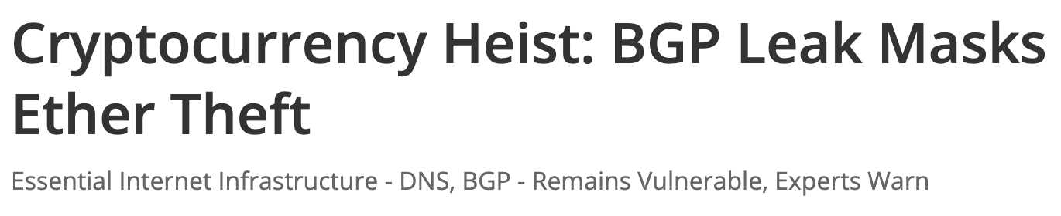
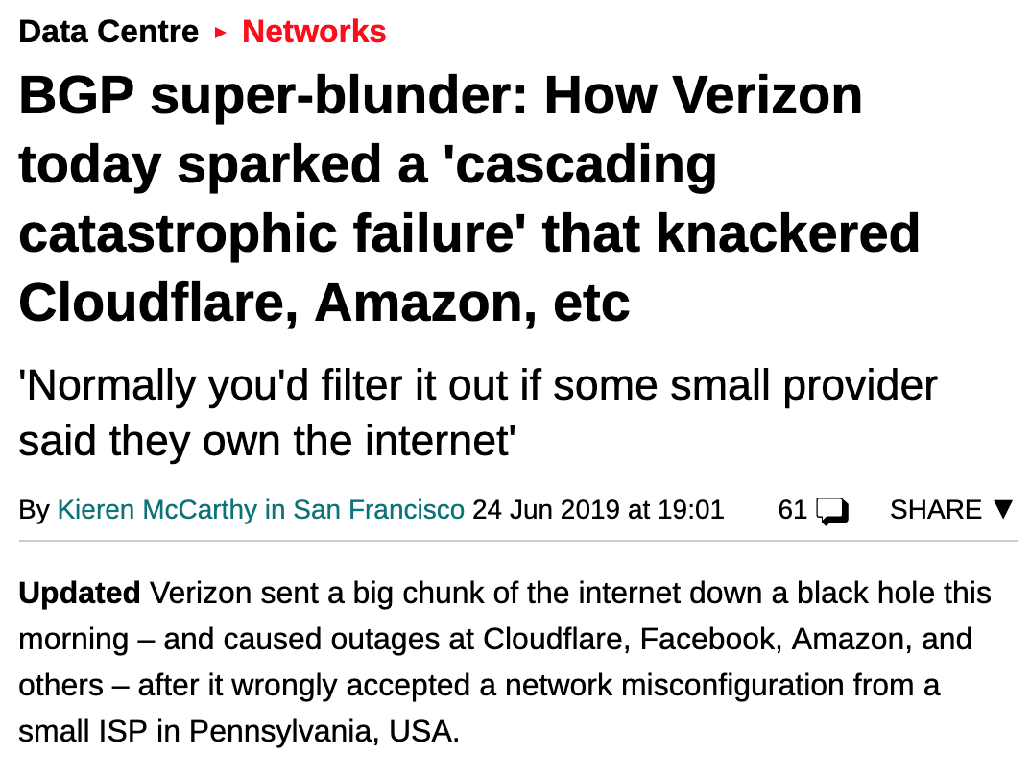

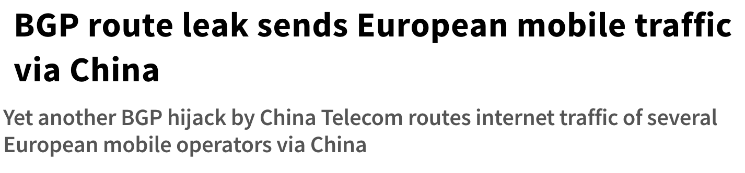
BGP security is severely lacking
BGP trust model makes
Resource Public Key Infrastructure (RPKI) proposed to fix some of the problems.

Slide 40
Advanced BGP topics (We just scratched the surface)
BFD
BGP in datacenters
BGP over GRE
BGP over MPLS
Capability negotiation
Communities
Confederations
Extended communities
EVPN
Flowspec
Inter-AS VPNs a b c
L2VPN
L3VPN
Labeled Unicast
Link State BGP
Link State BGP
Multihoming
Multipath
Outbound Route Filters
Redistribution
Route reflectors
Route servers
RPKI
SD-WAB
Secure BGP
Segment Routing
YANG models
Etc. etc. etc….

